Slide 1
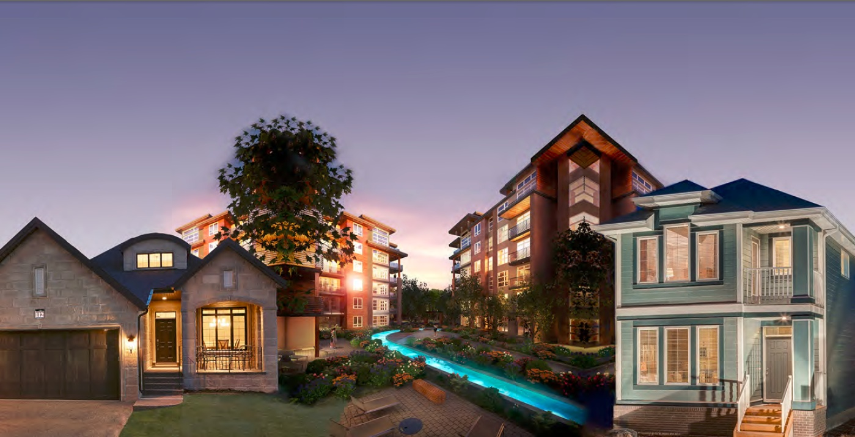
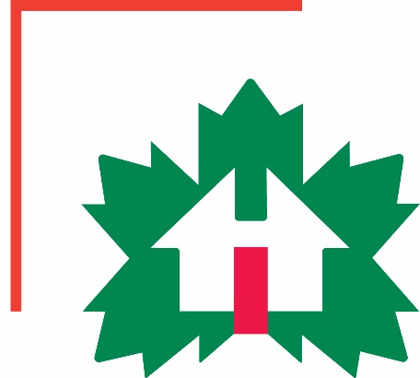
Factory-Built Housing in Canada – Evolution, Regulatory Requirements and Confirmation of Compliance
Prepared for Municipal Officials in British Columbia August 2017

Slide 2
Factory-Built Housing in Canada
Purpose ─ To provide local government officials in BC with current information on:
today’s factory-built housing & the Canadian industry
regulatory requirements that apply to factory-built housing in BC
technical and administrative
confirming compliance
issues and solutions
0 -
Notes:
Module 0 – Purpose
The purpose of this presentation material is to provide municipal officials in BC with information on:
prefabricated buildings in Canada today
building regulatory requirements that apply to prefabricated buildings in BC, both technical and administrative
and
current issues and solutions.

Slide 3
Factory-Built Housing in Canada: Issues in BC
CSA Z240.10.1 “Site Preparation, Foundation and Anchorage of Manufactured Homes”
acceptance of foundations and anchorage that comply with the standard
see Module 4
Permitting, inspection and acceptance
what is needed for acceptance
see Module 6
Municipal Bylaws
see Module 7
0 -
Notes:
Module 0 – Issues in BC
There are three main issues that face the prefabricated building industry in BC today:
the acceptance of foundations and anchorage that comply with CSA Z240.10.1 which provides requirements for surface foundations and is referenced in the BC Building Code
permitting, inspection and acceptance of homes constructed in accordance with the BC Building Code
and
discriminatory bylaws.
Foundations and Anchorage are discussed in Module 4
Permitting, inspection and acceptance of prefabricated homes are discussed in Module 6.
Municipal bylaws are discussed in Module 7 along with some other challenges that are faced across the country.

Slide 4
Modules
Who We Are – CHBA-MOD and MHABC
Factory-Built Housing - Then and Now
The Industry
0 -
Notes:
Module 0 – Outline – Slide 1 of 3
The presentation material is provided in eight modules.
The first three modules provide
an introduction to - the CHBA’s Modular Construction Council, and - the Manufactured Housing Association of BC
followed by an overview of factory building in Canada
and some information on the industry

Slide 5
Modules
Who We Are – CHBA-MOD and MHABC
Factory-Built Housing - Then and Now
The Industry
Applicable Technical Requirements
Facilitating Compliance
Confirming Compliance
0 -
Notes:
Module 0 – Outline – Slide 2 of 3
Modules 4 to 6 provide the meat of the material.
They describe how prefabricated buildings fit into BC’s regulatory context in terms of - the technical requirements that apply
- how prefabrication facilitates compliance - and how compliance is confirmed.

Slide 6
Modules
Who We Are – CHBA-MOD and MHABC
Factory Built Housing - Then and Now
The Industry
Applicable Technical Requirements
Facilitating Compliance
Confirming Compliance
Challenges
Take-Aways
0 -
Notes:
Module 0 – Outline – Slide 3 of 3
Module 7 discusses challenges that aren’t covered in the preceding modules.
Module 8 provides a summary of the most important points.

