Slide 1
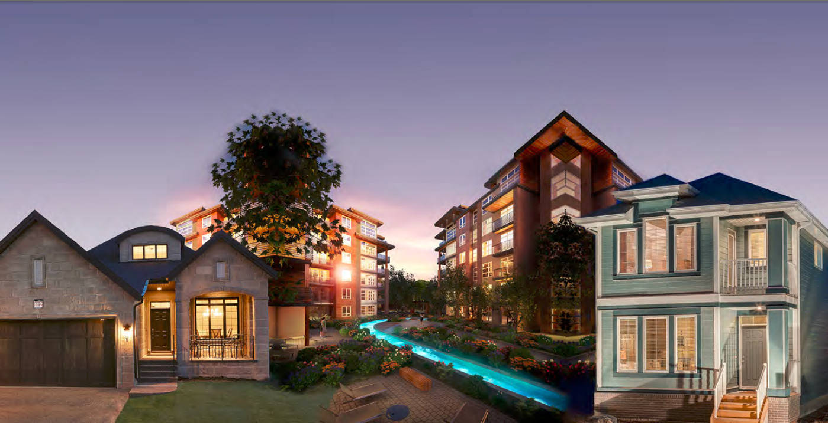
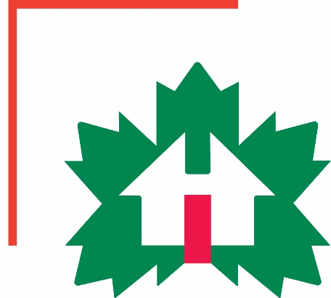
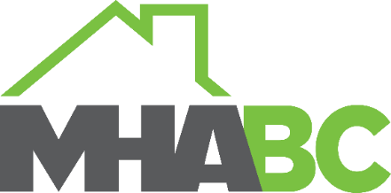
Factory-Built Housing in Canada – Evolution, Regulatory Requirements and Confirmation of Compliance
Module 3: The Factory-Built Housing Industry
Prepared for Municipal Officials in British Columbia August 2017

Slide 2
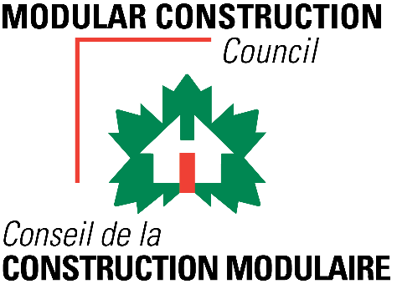
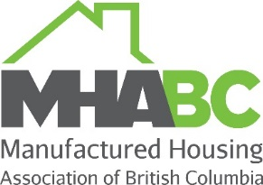
The Modules
Who We Are – CHBA-MOD and MHABC
Factory-Built Housing - Then and Now
The Industry
Applicable Technical Requirements
Facilitating Compliance
Confirming Compliance
Challenges
Take-Aways
3 -
Notes:
Module 3 – The Industry
Module 3 provides an overview of the prefabricated building industry in Canada

Slide 3
The Industry – Highlights 2015
Value of the Industry - National
supported over 25,500 full time jobs
contributed over $1.6 billion in economic activity
contributed $588 million in federal and provincial taxes
[CMHI Manufactured Building Survey]
3 -
Notes:
Module 3 – Industry – Highlights 2015
National
Prefabricated building construction is an important industry in Canada.
The most recent statistics available are from 2015.
In 2015, the industry
supported over 25,500 full time jobs
contributed over $1.6 billion in economic activity
contributed $588 million in federal and provincial taxes.

Slide 4
The Industry – Highlights 2015
Value of the Industry – British Columbia
3 -
Notes:
Module 3 – Industry – Highlights 2015
British Columbia
In BC, the prefabricated building construction
supported 2,792 jobs
contributed $614 million in economic activity
contributed $78 million in federal and provincial taxes
and
provided $284 million in wages and business profits

Slide 5
The Industry – Single Family – 2015
National
15,734 factory-built single-family homes
15.6% of the single- family market
3 -
Notes:
Module 3 – Industry – National
Single Family - Share
In 2015, prefabricated single family homes constituted
more than 15% of the single-family market
And the share continues to grow.

Slide 6
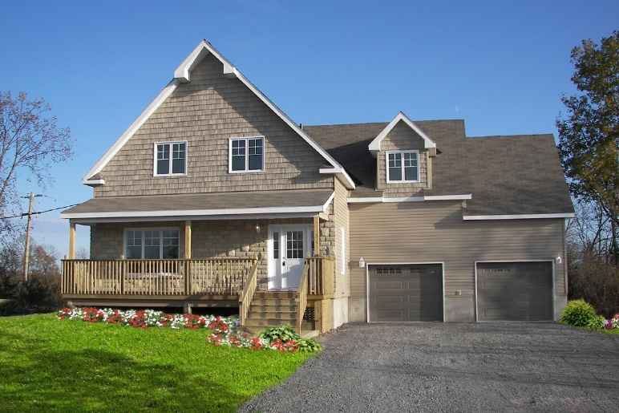
The Industry – Certified Factories – 2015
Certified Factories: CSA A277 & CSA Z240 MH
Location | 2001 | 2007 | 2009 | 2016
BC | 7 | 8 | 8 | 21
AB | 16 | 28 | 34 | 37
SK | 4 | 6 | 9 | 11
MB | 3 | 3 | 6 | 7
ON | 6 | 6 | 7 | 12
QC | 17 | 18 | 16 | 20
NB | 5 | 5 | 5 | 6
NL | 1 | 1 | - | -
Canada | 59 | 75 | 85 | 114
China | - | - | - | 3
South Korea | - | - | - | 1
United States | 1 | 5 | 15 | 42
Total | 60 | 80 | 100 | 160
Source: Canadian Manufactured Housing Institute based on data provided by CSA, Intertek Testing Services and Quality Auditing Institute
Number of factories certified to produce housing for Canada
up 18 from 142 in 2015 to 160 in 2016
Guildcrest Homes
3 -
Notes:
Module 3 – Industry – Factories
The number of factories in Canada and around the world
certified to build to Canadian requirements
continues to increase.
In 2016, there were 21 certified plants in BC.

Slide 7
The Industry – BC Factories
MHABC Member Factories
Britco Construction
Chaparrel Built
Freeport Industries
Moduline Industries (Canada) - Penticton, Medicine Hat
Palm Harbor Homes
SRI Homes (Kelowna, Lethbridge, Estevan
Stratford Building Corporation
Triple M Homes
3 -
Notes:
Module 3 – Industry – Factories
The certified plants in BC that are members of MHABC are:
Britco Structures
Chaparrel Industries
Freeport Industries
Moduline Industries (Canada)
SRI Homes
Stratford Building Corporation

