Slide 1
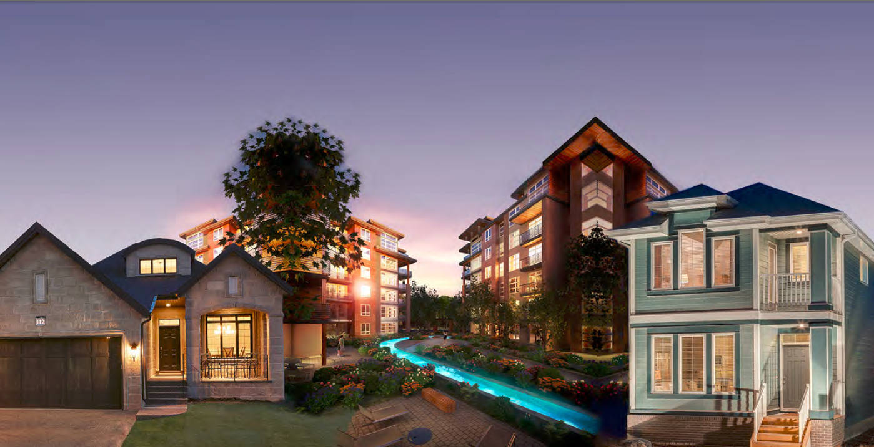
Factory-Built Housing in Canada – Evolution, Regulatory Requirements and Confirmation of Compliance
Module 7: Challenges
Prepared for Municipal Officials in British Columbia August 2017

Slide 2
Modules
Who We Are – CHBA-MOD and MHABC
Factory-Built Housing - Then and Now
The Industry
Applicable Technical Requirements
Facilitating Compliance
Confirming Compliance
Challenges
Take-Aways
7 -
Notes:
Module 7 - Outline
This module describes some of the challenges that are being faced by the prefabricated building industry today.

Slide 3
Challenges
Subjects
acceptance of surface foundations and anchorage that complies with CSA Z240.10.1. Site Preparation, Foundation and Installation of Buildings
acceptance of prefabricated buildings that comply with the BC Building Code based on certification in accordance with CSA A277 Procedure for Certification of Prefabricated Buildings Modules and Panels
6 -
Notes:
Module 6 – Confirming Compliance
Subjects
Two of the main challenges that the industry is facing in BC have been discussed in previous modules
Acceptance of surface foundations and anchorage that comply with CSA Z240.10.1 is discussed in Module 4
Acceptance of prefabricated buildings that comply with the BC Building Code based on CSA A277 certification is discussed in Module 6.
Three additional challenges are discussed in this module:
Two are related to land-use bylaws
discrimination against prefabricated buildings
park model trailers
The third relates to energy efficiency and transportation.

Slide 4
Challenges
Subjects
acceptance of surface foundations and anchorage that complies with CSA Z240.10.1. Site Preparation, Foundation and Installation of Buildings
acceptance of prefabricated buildings that comply with the BC Building Code based on certification in accordance with CSA A277 Procedure for Certification of Prefabricated Buildings Modules and Panels
Land-use bylaws
discrimination against prefabricated buildings
park model trailers
Energy efficiency and transportation
6 -
Notes:
Module 6 – Confirming Compliance
Subjects
Three additional challenges are discussed in this module.
Two are related to land-use bylaws
discrimination against prefabricated buildings
park model trailers
The third relates to energy efficiency and transportation.

Slide 5
Challenges
Land-Use Bylaws – Discrimination
Supreme Homes
Moduline,BC
7 -
Notes:
Module 7 – Challenges –
Land-Use Bylaws – Discrimination
There are cases where land-use bylaws discriminate against prefabricated homes.
sometimes this appears to be intentional
sometimes it appears more accidental because the terminology that is used many not be consistent with current industry use.
It is understandable that a municipality may not want prefabricated houses such those illustrated on this slide….

Slide 6
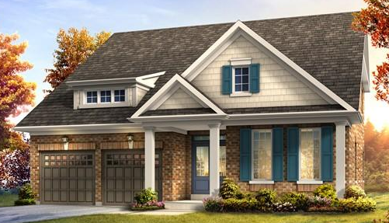
Challenges
Land-Use Bylaws – Discrimination
Supreme Homes
Brookfield Homes
Moduline,BC
Brookfield Homes
7 -
Notes:
Module 7 – Challenges –
Land-Use Bylaws – Discrimination
… to be mixed in with site-built houses such as these.

Slide 7
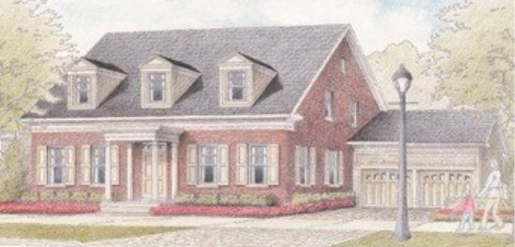
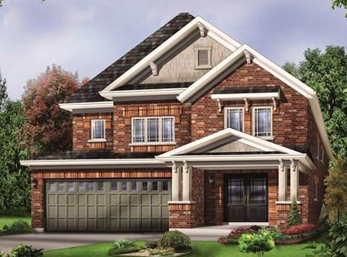
Challenges
Land-Use Bylaws – Discrimination
Brookfield Homes
Brookfield Homes
7 -
Notes:
Module 7 – Challenges –
Discriminatory Bylaws
But if site-built houses in the area look like this ….

Slide 8
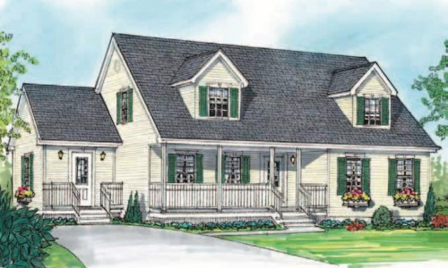
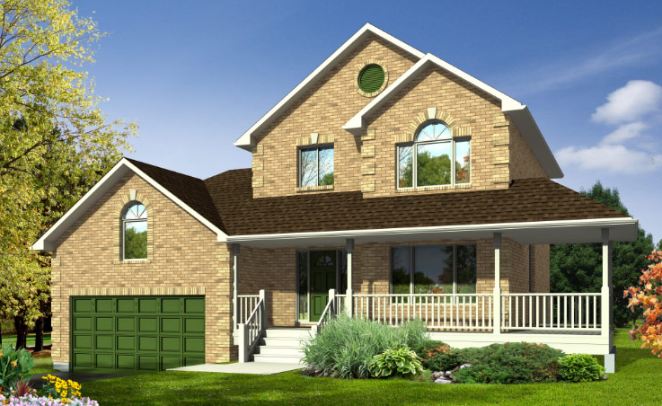
Challenges
Land-Use Bylaws – Discrimination
Maple Leaf Homes
Brookfield Homes
Guildcrest Homes
7 -
Brookfield Homes
Notes:
Module 7 – Challenges –
Land-Use Bylaws – Discrimination
… it’s hard to argue that prefabricated homes should be prohibited when they can look the same or very similar.

Slide 9
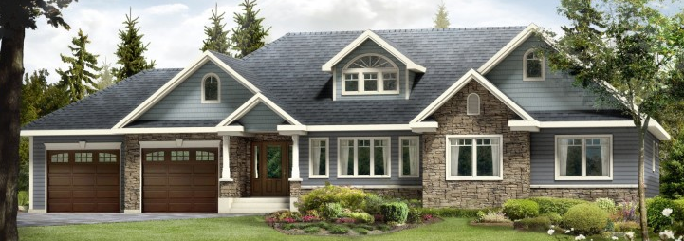
Challenges
Land-Use Bylaws – Discrimination
Supreme Homes
Profab Homes
Triple M Housing
7 -
Notes:
Module 7 – Challenges –
Land-Use Bylaws – Discrimination
Discriminating against prefab – all of these homes are prefabricated – cannot be supported
As discussed in Module 2, it is also counter-productive in terms of providing quality, energy efficient and sustainable housing.

Slide 10
Challenges
Land-Use Bylaws – Discrimination
7 -
Notes:
Module 7 – Challenges –
Land-Use Bylaws – Discrimination
The Modular Housing Association of the Prairie Provinces has developed a set of guidelines that can be used where architectural compatibility is an issue

Slide 11
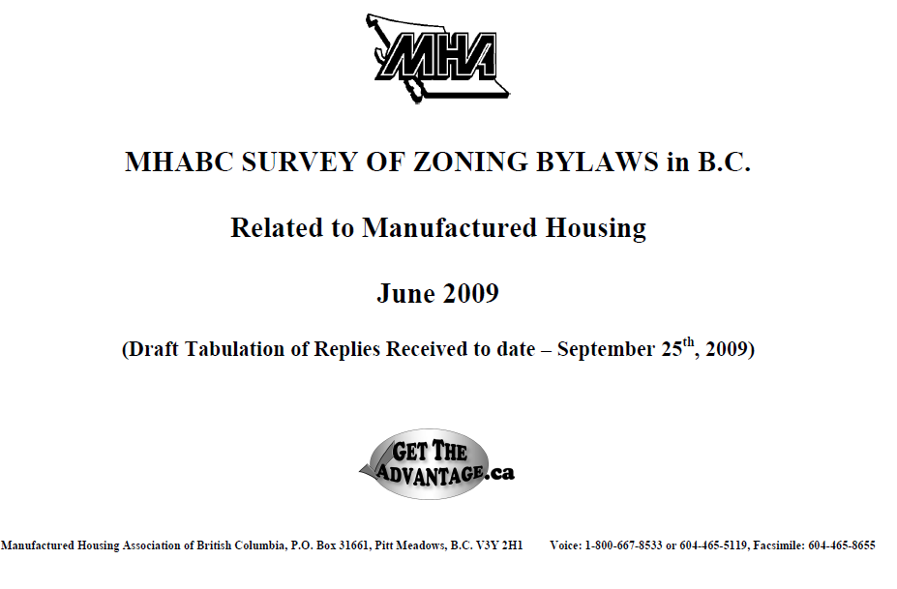
Challenges
A survey of community by-laws across BC found many restrictive by-laws for locating of manufactured and modular homes
7 -
Notes:
Module 7 – Challenges –
Land-Use Bylaws – Discrimination
An extensive survey of local government across BC found many restrictive by-laws on where and how factory-built could be located and set-up.

Slide 12
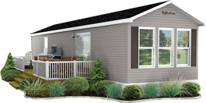
Challenges
Land-Use Bylaws – Park Model Trailers
a recreational unit, not a dwelling unit
meant to be installed in “parks” or “resorts”
if park/resort is open year-round, encourages use as a dwelling unit
if installed in a residential land-use zone
year-round occupancy permitted
unfairly threatens viability of construction companies that comply with requirements for dwelling units
7 -
Notes:
Module 7 – Challenges
Land-Use Bylaws – Park Model Trailers
The difference between a park model trailer and a manufactured home has been described in Module 4.

Slide 13
Challenges
Land-Use Bylaws – Park Model Trailers
a recreational unit, not a dwelling unit
meant to be installed in “parks” or “resorts”
if park/resort is open year-round, encourages use as a dwelling unit
if installed in residential land-use zones
year-round occupancy permitted
7 -
Notes:
Module 7 – Challenges
Land-Use Bylaws – Park Model Trailers
The difference between a park model trailer and a manufactured home has been described in Module 4.
Park model trailers are meant to be installed in parks or resorts for use in the non-heating season.
if park/resort is open year-round, encourages use as a dwelling unit
If park model trailers are permitted to be installed in residential land-use zones
year-round occupancy permitted

Slide 14
Challenges
Land-Use Bylaws – Park Model Trailers
Implications
unfair competition for home builders who comply with requirements for dwelling units
no requirements related to installation location
danger of structural failure in high snow or seismic load areas
energy–related requirements far below BCBC and CSA Z240 MH Series
contrary to provincial policy to reduce energy use and greenhouse gas emissions.
7 -
Notes:
Module 7 – Challenges
Land-Use Bylaws – Park Model Trailers
Aside from property tax issues, encouraging or permitting year-round occupancy
unfairly threatens viability of companies that produce homes that comply with requirements for dwelling units
With no requirements related to installation location, there is a danger of structural failure in high snow or seismic load areas
With virtually no energy–related requirements, permitting occupancy year-round is
contrary to provincial policy to reduce energy use and greenhouse gas emissions.

Slide 15
Challenges
Energy Efficiency and Transportation
maximum dimensions
regulations, infrastructure, geography
increases in thermal resistance levels = increases in building envelope thickness
Maple Leaf Homes
7 -
Notes:
Module 7 – Challenges
Energy Efficiency and Transportation
Energy efficiency.
New homes have taken the brunt of recent initiatives despite ever-improving performance achieved on a voluntary basis.
Prefabricated buildings face special challenges because of the dimensional restrictions imposed by transport regulations, infrastructure and geography.
Needless to say, this is particularly problematic in BC where load width may be reduced to a maximum 14’.
So far, the challenges resulting from increases in minimum insulation levels have not proven to be insurmountable.
As we move toward 2030 and net-zero ready, the challenges could become significant, particularly for smaller homes.
The difficulty of achieving net-zero ready for smaller homes has already been recognized by the Province of BC.
The industry will be paying very close attention to how new requirements are proposed to be implemented.

