Slide 1
Factory-Built Housing in Canada – Evolution, Regulatory Requirements and Confirmation of Compliance
Module 4: Technical Requirements for Factory-Built Homes
Prepared for Municipal Officials in British Columbia August 2017

Slide 2
Modules
Who We Are – CHBA-MOD and MHABC
Factory-Built Housing - Then and Now
The Industry
Technical Requirements
Facilitating Compliance
Confirming Compliance
Challenges
Take-Aways
4 -
Notes:
Module 4 – Applicable Technical Requirements
Module 4 describes the technical requirements that apply to prefabricated buildings in BC

Slide 3
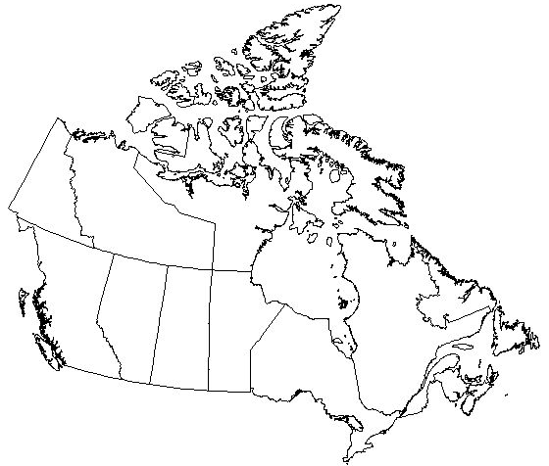
Technical Requirements
National Model Construction Codes
YK
NU
NT
British
Columbia
NL
AB
MB
SK
QC
ON
PE
NB
NS
4 -
Notes:
Module 4 – Technical Requirements
Building regulations in British Columbia, like building regulations in all the provinces and territories, are based on the national model codes.

Slide 4
Technical Requirements
Acts
BC Building Act 2015
BC Manufactured Home Act
BC Energy Efficiency Standards Act
4 -
Notes:
Module 4 – Technical Requirements
Building regulations in BC fall under
the BC Building Act
the BC Manufactured Homes Act and
the BC Energy Efficiency Standards Act
The Manufactured Home Act addresses:
registration of these homes
ownership transfers
transportation permits if a home is moved
and payment of taxes.
It does not include technical requirements.

Slide 5
Technical Requirements
Regulations - Provincial:
BC Building Code
BC Fire Code
BC Plumbing Code
BC Energy Efficiency Standards Regulation
Regulations - Local:
Vancouver Building Bylaw
Solar Hot Water Ready Regulation - 48 jurisdictions
4 -
Notes:
Module 4 – Technical Requirements
The related regulations that apply across the province are:
BC Building Code
BC Fire Code,
BC Plumbing Code
BC Energy Efficiency Standards Regulation
The one exception is Vancouver which has its own building code – the Vancouver Building Bylaw
There is also a Solar Hot Water Ready Regulation
As of June 1 2017, it had been adopted in 49 local government jurisdictions
_________________________________
Additional Detail –
The Solar Hot Water Ready Regulation addresses
minimum usable roof area
roof structure and
conduit runs from the roof area to the space where the service water heater is located.
Once a jurisdiction has opted in, exceptions are permitted only where the building site does not permit effective solar water heating

Slide 6
Technical Requirements
Regulations - Provincial:
BC Building Code
BC Fire Code
BC Plumbing Code
BC Energy Efficiency Standards Regulation
Regulations - Local:
Vancouver Building Bylaw
Solar Hot Water Ready Regulation - 48 jurisdictions
4 -
Notes:
Module 4 – Technical Requirements
This discussion of requirements that apply to prefabricated buildings focuses on the BC Building Code.

Slide 7
Technical Requirements
British Columbia Building Code (BCBC)
is based on the NBC with some variations; e.g.,
minimum performance of windows and doors with respect to water penetration resistance does not depend on exposure
mechanical ventilation in dwelling units is required to operate continuously
this has implications for “manufactured homes”
4 -
Notes:
Module 4 – Technical Requirements
The BC Building Code is based on the National Building Code with some variations such as:
the recent revisions to the requirements for windows an doors so water resistance does not depend on exposure
the requirement for continuous ventilation in dwelling units

Slide 8
Technical Requirements
British Columbia Building Code (BCBC)
for prefabricated buildings – the basics
1. all site work is subject to the applicable requirements of the BCBC
4 -
Notes:
Module 4 – Technical Requirements
For prefabricated buildings,
all site work is subject to the applicable requirements of the Code This subject will be discussed in more detail later.
….

Slide 9
Technical Requirements
British Columbia Building Code (BCBC)
for prefabricated buildings – the basics
1. all site work must comply with the applicable requirements of the BCBC
2. all work done in the factory must comply with
a) the applicable requirements of the BCBC
b) Except for
4 -
Notes:
Module 4 – Technical Requirements
….
all work done in the factory is subject to - - the applicable requirements of the Code Except that …

Slide 10
Technical Requirements
British Columbia Building Code (BCBC)
for prefabricated buildings – the basics
1. all site work must comply with the applicable requirements of the BCBC
2. all work done in the factory must comply with
a) the applicable requirements of the BCBC
b) Except for 1-storey single-family homes that comply with CSA Z240 MH Series, “Manufactured Homes”
4 -
Notes:
Module 4 – Technical Requirements
….
the Code does not apply to 1-storey single family homes that comply with the CSA standard Z240 MH Series, Manufactured Homes.
The remainder of this module provides information specific to
manufactured homes
and
site work including foundations and anchorage for all prefabricated buildings.

Slide 11
Technical Requirements
CSA Z240 MH Series Manufactured Homes
Definition Manufactured home — a transportable, single- or multiple-section, one-storey dwelling that is ready for occupancy on completion of set-up in accordance with the manufacturer’s installation instructions.
Note: Setup may include mating of multiple-section homes, painting, and installation of floor finishes, cabinetry, final light fixtures, solid fuel-fired appliances, gas appliances and systems, chimneys and flues.
4 -
Notes:
Module 4 – Technical Requirements
Z240 MH Series
The Z240 MH Series standard defines a manufactured home as
“a transportable, single- or multiple-section, one-storey dwelling that is ready for occupancy on completion of set-up in accordance with the manufacturer’s installation instructions.”
These homes:
may or may not be constructed on a chassis
and
may be designed for installation on - a point-load surface foundation, or - a full-perimeter foundation.

Slide 12
Technical Requirements
CSA Z240-16 MH Series Manufactured Homes
significant updates from 2009 edition:
NBC is the default
exceptions or additional requirements provided only as necessary to address issues specific to prefabricated buildings
few remaining requirements that are less stringent than the NBC
some lower energy efficiency performance levels
greater floor deflection allowed where assembly is not supporting a gypsum board ceiling or rock, ceramic or porcelain tile flooring
some additional differences when compared to the BC Building Code
4 -
Notes:
Module 4 – Technical Requirements
The CSA Z240 MH Series standard was updated in 2016.
There were some significant changes.
The standard references the National Building Code and then provides some exceptions or additional requirements to address issues that are specific to prefabricated buildings.
The only significant difference is in the area of energy efficiency.
As noted, there are also some differences when compared to the BC Building Code.

Slide 13
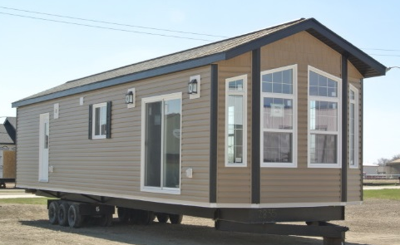
Technical Requirements
CSA Z240 MH Series Manufactured Homes
NOT to be confused with CSA Z241, “Park Model Trailers”
Sidebar
4 -
Notes:
Module 4 – Technical Requirements
Side-Bar
Manufactured homes should not be confused with park model trailers, which are constructed to a different standard and are not intended to be used year-round.

Slide 14
Technical Requirements
Park model trailer — a recreational unit that meets the following criteria:
a) it is built on a single chassis mounted on wheels;
b) it is designed to facilitate relocation from time to time;
c) it is designed as living quarters for seasonal camping and may be connected to those utilities necessary for operation of installed fixtures and appliances; and
d) it has a gross floor area, including lofts, not exceeding 50 m² when in the set-up mode, and has a width greater than 2.6 m in the transit mode.
Sidebar
4 -
Notes:
Module 4 – Technical Requirements
Park model trailers MUST be constructed on a chassis.
They are meant to be used only for temporary accommodation in the warmer seasons.
and the standard specifies dimensional limits.

Slide 15
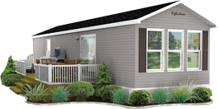
Technical Requirements
Manufactured Homes Park Model Trailers
Sidebar
Grandeur Homes, MB
Moduline, BC
4 -
Notes:
Module 4 – Technical Requirements
Z240 MH vs. Z241
While some park model trailers may look similar to some manufactured homes, their construction is quite different.
For example, for park model trailers:
minimum insulation levels are RSI 1.41 (R-8) in the walls and RSI 2.11 (R-12) in the floor and ceiling,
there are no requirements for air barriers or vapour barriers
no standard is referenced for windows
Park model trailers are not recognized as buildings in the BC Building Code.

Slide 16
Technical Requirements
Site Work
must comply with the BC Building Code
in all cases:
siting; e.g., re. spatial separation
site preparation [9.12.]
footings and foundations [9.15.]
service hook-ups
other work not completed in the factory
for multi-module buildings
“stitching” together to maintain integrity of protection - air barrier, vapour barrier, insulation - weather barrier, cladding, roofing - fire protection
4 -
Notes:
Module 4 – Technical Requirements
Site Work
As noted, all site-work must comply with the BC Building Code.
For all prefabricated buildings, this includes:
siting; to comply, for example, with the spatial separation requirements
site preparation [9.12.]
footings and foundations [9.15.]
service hook-ups
other work not completed in the factory
For multi-module buildings, the BC Building Code requirements apply to “stitching” the modules together to maintain integrity of the building envelope and fire protection.

Slide 17
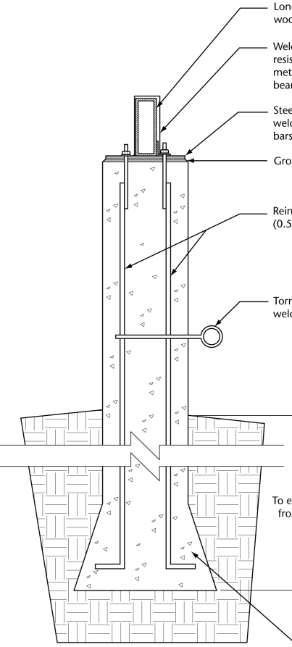
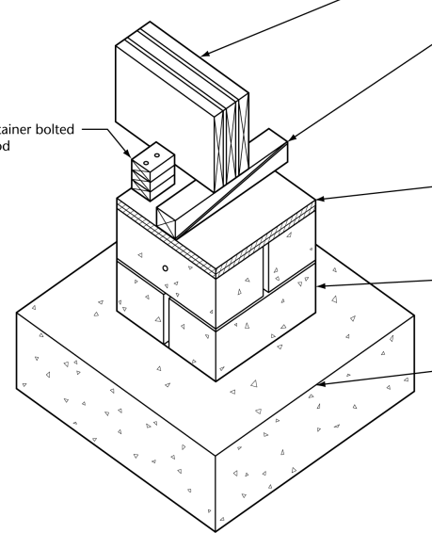
Technical Requirements
Foundations for All Prefabricated Buildings
all buildings to be installed on “permanent foundations”
foundations that comply with Code
Part 9 options:
perimeter foundations - depth depending on soil type and frost
point-support in-ground foundations (piles designed to Part 4) - depth depending on soil type, frost depth
point-support surface foundations - limits on application
CSA Z240.10.1-16
4 -
Notes:
Module 4 – Technical Requirements
Foundations
Prefabricated buildings must be installed on permanent foundations.
The industry considers a permanent foundation to be any foundation that complies with Code.
Part 9 offers a number of options:
full-perimeter foundations with depth depending on soil type and frost depth
point-support in-ground foundations - engineered piles– again with depth depending on soil type and frost depth
and
point-support surface-foundations with some limitations on use

Slide 18
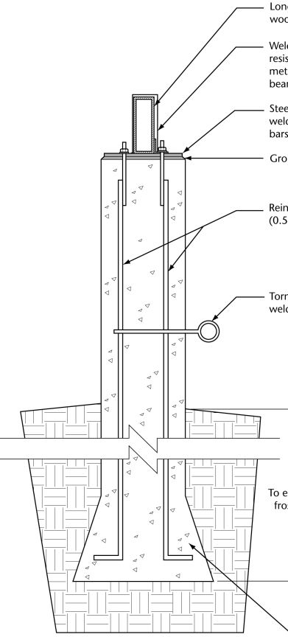
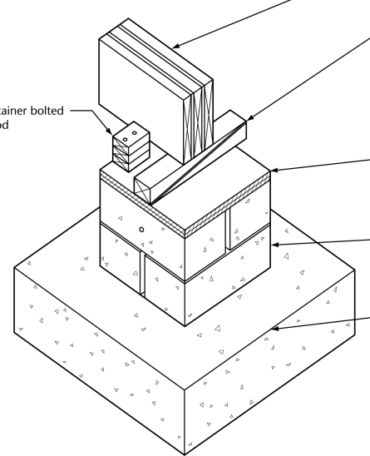
Technical Requirements
Foundations
all buildings to be installed on “permanent foundations”
foundations that comply with Code
Part 9 options:
perimeter foundations - depth depending on soil type and frost
point-support in-ground foundations (piles designed to Part 4) - depth depending on soil type, frost depth
point-support surface foundations - limits on application
CSA Z240.10.1 Site Preparation, Foundation and Anchorage of Manufactured Homes
CSA Z240.10.1-16
4 -
Notes:
Module 4 – Technical Requirements
Foundations
This last option is where CSA Z240.10.1 comes into play.

Slide 19
Technical Requirements
Foundations
point-support surface foundations permitted where:
foundation complies with Z240.10.1 Site Preparation, Foundation and Anchorage of Manufactured Homes [referenced in BCBC 9.15.1.3.]
AND
the building
is not on frost-susceptible soil [see BCBC Table 9.12.2.2.]
OR
a) has no masonry AND b) passes the deformation resistance test in Z240.2.1 Technical Requirements for Manufactured Homes [see BCBC 9.12.2.2.(6) and 9.15.1.3.]
4 -
Notes:
Module 4 – Technical Requirements
Foundations
The BC Building Code permits point-support surface-foundations where:
the building is detached
the foundation complies with Z240.10.1 Site Preparation, Foundation and Anchorage of Manufactured Homes [ref. BCBC 9.15.1.3.]
and
the building
is not on frost-susceptible soil [ref. BCBC Table 9.12.2.2.]
OR
a) has no masonry AND
b) passes the deformation resistance test in Z240.2.1 Technical Requirements for Manufactured Homes [ref. BCBC 9.12.2.2.(6) and 9.15.1.3.]
It is easy to confirm whether a building has masonry.
Confirming compliance with the deformation resistance test is discussed in Module 6.

Slide 20
Technical Requirements
Anchorage
all buildings must be anchored against wind and earthquake loads unless this can be shown to be unnecessary [ref. BCBC 9.23.6.1]
Part 9 options:
embedding floor joists in perimeter foundation [9.23.6.1.(2)(a)]
anchoring sill plate to perimeter foundation [9.23.6.1.(2)(b)]
anchoring in compliance with Z240.10.1 Site Preparation, Foundation and Anchorage of Manufactured Homes [BCBC 9.23.6.3.] where the building is
not more than 4.3 m wide (14’)-
1 storey in building height
4 2
Notes:
Module 4 – Technical Requirements
Anchorage
Similarly, all prefabricated buildings must be anchored in accordance with the BC Building Code unless this can be shown to be unnecessary.
Part 9 provides three options:
embedding floor joists in a perimeter foundation [BCBC 9.23.6.1.(2)(a)]
anchoring sill plate to a perimeter foundation [BCBC 9.23.6.1.(2)(b)]
anchoring in compliance with Z240.10.1 Site Preparation, Foundation and Anchorage of manufactured Homes [BCBC 9.23.6.3.] where the building is
not more than 4.3 m wide (14’)-
1 storey in building height

Slide 21
Technical Requirements
Anchorage
Z240.10.1 Site Preparation, Foundation and Anchorage of Manufactured Homes [BCBC 9.23.6.3.]
where anchorage is required depending on resistance to overturning and pier toppling due to wind
minimum pull-out resistance
determined by engineering
OR
two deemed to comply solutions
minimum installation depth
maximum spacing
where means of adjustment is required
4 2
Notes:
Module 4 – Technical Requirements
Anchorage
Z240.10.1 specifies
where anchorage is required
minimum pull-out resistance - which must be determined by engineering OR - by using one of two deemed to comply solutions
minimum depth
maximum spacing
where means to adjust the length of the anchors is required

Slide 22
Technical Requirements
Z240.10.1-16 Site Preparation, Foundation and Anchorage of Manufactured Homes Installation of Buildings
Application
site preparation and skirting apply to all buildings on surface foundations
stitching applies to all multi-module buildings
foundation requirements apply where – - the building is 1 storey - no masonry, heavy roofing, or concrete floor topping - uniformly distributed live floor load ≤ 2.4 kPa
(limits to application of anchorage requirements are specified in the BCBC)
4 2
Notes:
Module 4 – Technical Requirements
Z240.10.1 – Updates - Application
A new edition of Z240.10.1 was published in 2016 titled Site Preparation, Foundation and Installation of Buildings to better reflect the scope and application of the standard.
The applications of various sets of requirements are more clearly and accurately stated:
site preparation and skirting apply to all buildings on surface foundations
stitching applies to all multi-module buildings
foundation requirements apply where – - the building is 1 storey - there is no masonry, heavy roofing*, or concrete floor topping
and - the uniformly distributed live floor load does not exceed 2.4 kPa
the limits to the application of the anchorage requirements are specified in the building code as described previously
*Heavy roofing includes concrete or clay roof tile

Slide 23
Technical Requirements
Z240.10.1-16
Technical
new Tables for minimum pier footing areas for buildings weighing not more than 1.9 kg/m² depending on - - soil bearing pressure - snow load - tributary area supported
new calculation and Tables for resistance to overturning due to wind depending on: - building weight - building width - spacing between supporting beams - 1-in-50 hourly wind pressure - updated wind exposure factors consistent with NBC Part 4
4 2
Notes:
Module 4 – Technical Requirements
Z240.10.1 – Updates - Technical
Notable technical updates include:
new Tables for minimum pier footing areas for buildings weighing not more than 1.9 kg/m2 depending on –
- soil bearing pressure - snow load - the tributary area supported
a new calculation and Tables for resistance to overturning due to wind to determine if anchorage is needed. The resistance values depend on –
- building weight - building width - spacing between supporting beams
- 1-in-50 hourly wind pressure
and
- exposure factors that have been updated consistent with Part 4 of the National Building Code.
These up-dates should give building officials even more confidence in accepting surface foundations and anchorage that complies with the standard.

